Slide 1

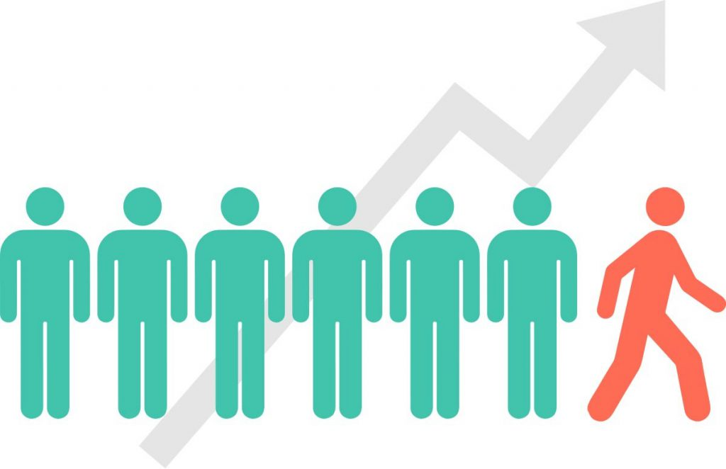

Churn Prediction in Telecom Industry
Infosys SpringBoard Batch II
Mentor: Mr. Bhaskar Naidu
Presented By: Amayara Yadav
Batch2_Churn_Modeling_On_Telecom_Data/AmayaraYadav at main · springboardmentor113/Batch2_Churn_Modeling_On_Telecom_Data (github.com)

Slide 2

AGENDA
About Telecom Churn Prediction
Our Mission and Vision
Our Goals
Milestones
Challenges
Data Cleaning and preprocessing
ML Model Building
Hyperparametertuning
SVM & Confusion Matrix
Conclusion

Slide 3



About Churn Prediction
Churn Prediction is a data driven process that forcasts which customers are likely to unsubscribe or stop using a company's product or services during a specific time.
Industries that uses churn prediction are :
Telecome industry
Banking sector
Subscription Based business

Slide 4
Benefits of Churn Prediction
Improved Customer Retention
Identify at-risk customers early
Implement targeted retention strategies
Reduce expenses on acquiring new customers

Slide 5

Challenges in churn Prediction
Data Quality Issues
Dynamic Customer Behaviour
Ethical Considerations
Interpretability of Models
Feature Selection

Slide 6
Reasons For Customer Churn
Dissatisfied with the product or servicesTechnical issues
Features missing
Poor Customer Services
Unresponsive Support
Lack of Personalization
Internet Issues
Pricing Issues
High Costs
Better Offers Elsewhere
Competition
Superior Alternatives
Promotional Offers:
Marketing and Communication Failures
Lack of Communication:
Inappropriate Marketing

Slide 7

OUR MISSION & VISION
OUR MISSION
OUR VISION
Telecom Churn Prediction contributes to the overall success and competitiveness of telecom company in a rapidly evolving market landscape.
Telecom churn Prediction can drive significant improvement in customer satisfaction,business performance and competitiveness within the telecommunication sector.

Slide 8

OUR GOALS
Minimize Churn Rate
Maximixe Customer Retention
Optimize Business Performance

Slide 9

Our Milestones
MILESTONE 1
Week 1: Data Collection
Week 2: Data Study
Week 3: Data Preprocessing Concepts
MILESTONE 2
Week 4: Data Preprocessing
Week 5: Model Building Concepts
Week 6: Model Building
Week 7: Hyperparameter tuning, SVM and Confusion Matrix
Week 8: Documentation
MILESTONE 3
MILESTONE 4

Slide 10

MILESTONE 1
Data Collection

Slide 11
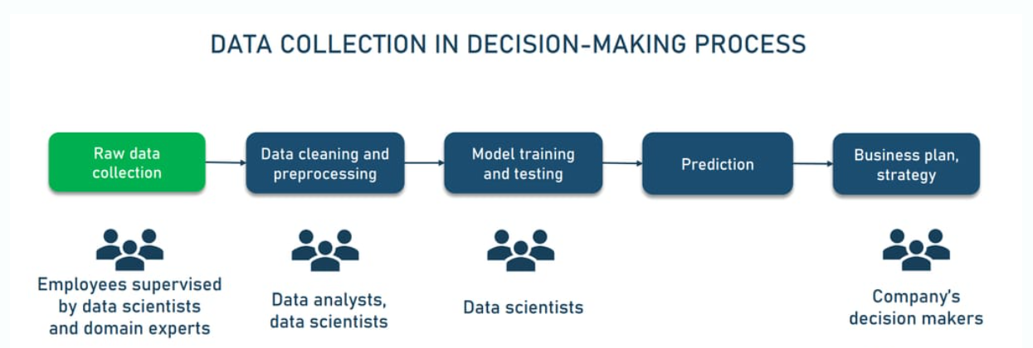
Data Collection
Data collection is a methodical practice aimed at acquiring meaningful information to build a consistent and complete dataset for a specific business purpose — such as decision-making, answering research questions, or strategic planning.

Slide 12
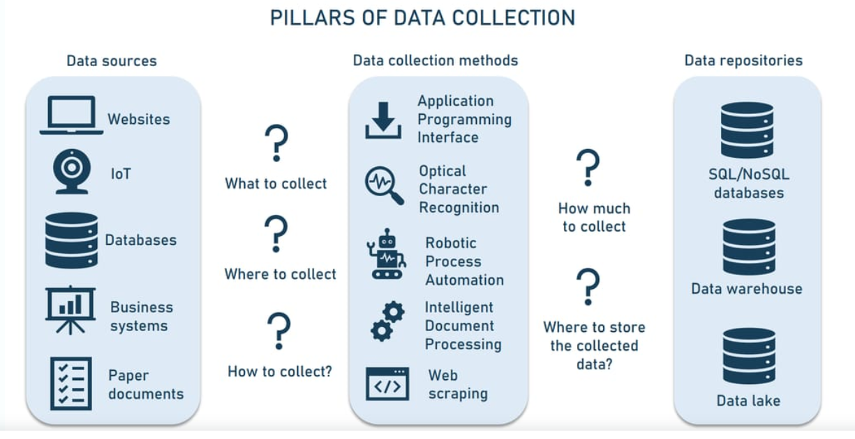

Slide 13
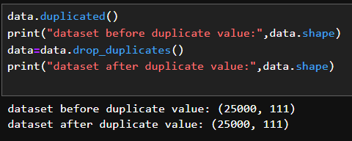
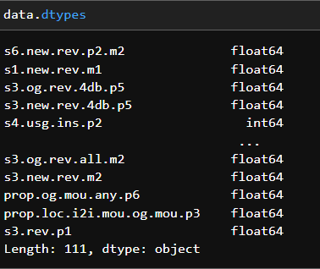
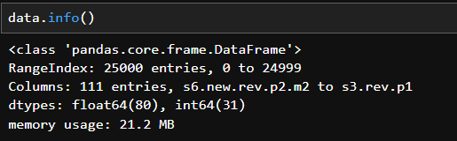
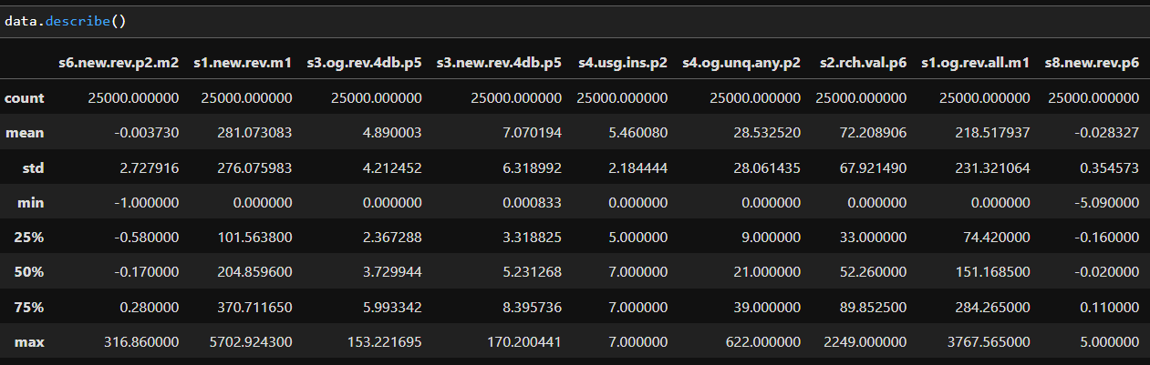
Code Snippets:
Contain 25000 rows and 111 columns

Slide 14

MILESTONE 2

Slide 15

Data Preprocessing
Data preprocessing is the process of transforming raw data into a clean and usable format. This step is crucial for ensuring that the data is suitable for building robust and accurate machine learning models.
It can include performing basic operations like
Dropping duplicate values
detecting missing values
Checking outliers and removing them
Removing multicollinearity
Checking correlation

Slide 16
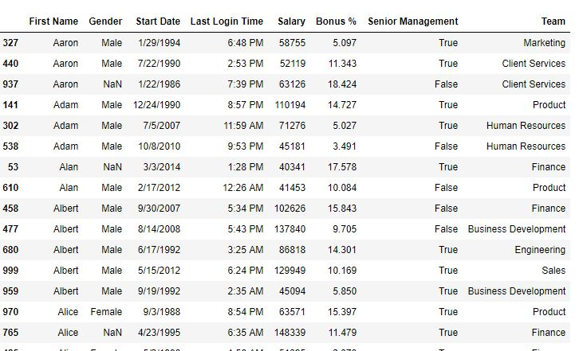
Duplicate Data
These are the values that keep occurring in our dataset and sometimes may be misleading.
Deduplication- process of dealing with duplicate values.

Slide 17
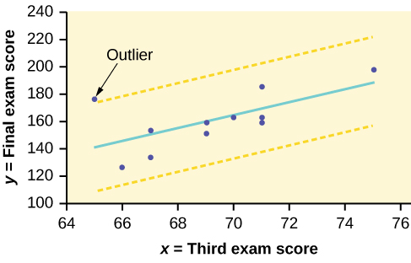
OUTLIERS
These are the data points that are different from the rest of the data.
However unlike noisy data, it can be informative for our analysis
various ways to handle outliers –
Inter Quartile range(IQR)
Box Plot
Use of statistical methods like median, average.

Slide 18
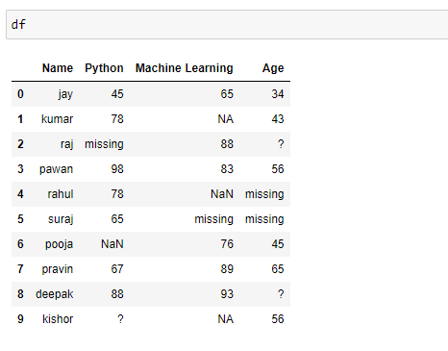
Missing Value
When values are missing in our data or are not applicable in our data
A simple and effective method to handle missing value is to omit them or replace them
Missing values can be detected by interploting the remaining value.
For a categorical attribute , the most reoccurring value is used.
Example: to find the temperature of an area, the most nearest or reoccurring value will be the answer.

Slide 19
Multicollinearity
Multicollinearity occurs when two or more predictor variables in a dataset are highly correlated, meaning that one can be linearly predicted from the others with a substantial degree of accuracy
Variance Inflation Factor (VIF):
VIF measures how much the variance of a regression coefficient is inflated due to multicollinearity with other predictor variables.
VIF=1/1-R*R
where R2R^2R2 is the coefficient of determination of the regression of that predictor on all the other predictors.
Interpretation:
VIF = 1: No correlation between the predictor and the other variables.
VIF > 1: Indicates correlation, with higher values indicating stronger correlation.
VIF > 5 or 10: Typically used as a rule of thumb indicating high multicollinearity that might need addressing.

Slide 20

MILESTONE 3
Model Building

Slide 21
MODEL BUILDING
RANDOM
FOREST
LOGISTIC
REGRESSION
DECISION TREE

Slide 22
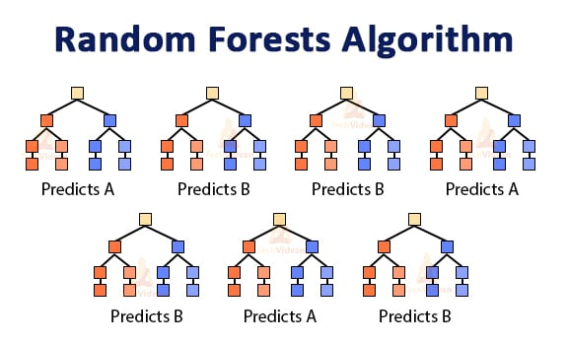
RANDOM FOREST
Random Forest algorithm is a powerful tree learning technique in Machine Learning It works by creating a number of Decision Trees during the training phase.
Each tree is constructed using a random subset of the data set to measure a random subset of features in each partition

Slide 23
BENEFITS
REDUCED RISK OF OVERFITTING
HIGH ACCURACY
LARGE DATASETS HANDLING
PROVIDES FLEXIBILITY
BUILT-IN CROSS-VALIDATION

Slide 24
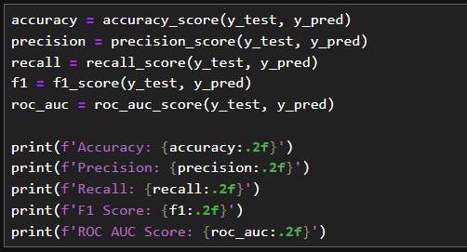
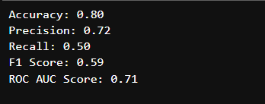
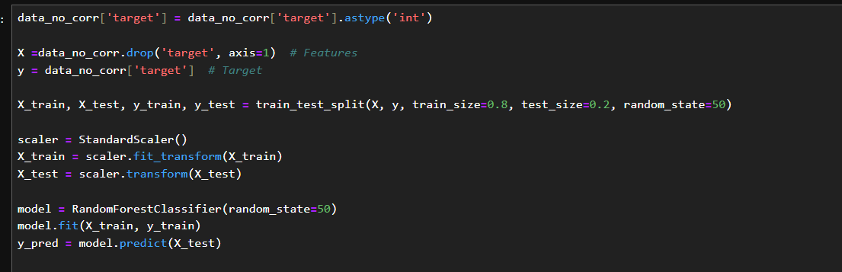
Code Snippet:

Slide 25
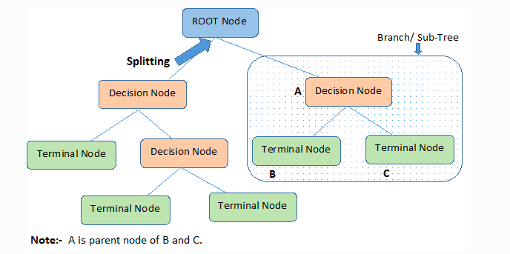
Decision Tree
A decision tree is a flowchart-like structure used to make decisions or predictions. It consists of nodes representing decisions or tests on attributes, branches representing the outcome of these decisions, and leaf nodes representing final outcomes or predictions

Slide 26
BENEFITS:
Step-by-step approach
Step-by-step approach
Easy to interpret:
More flexible

Slide 27
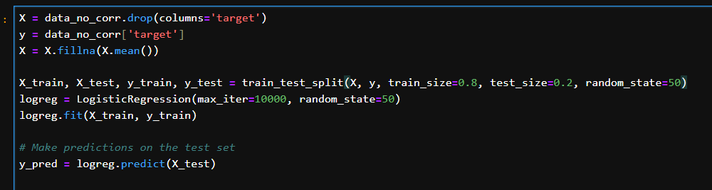
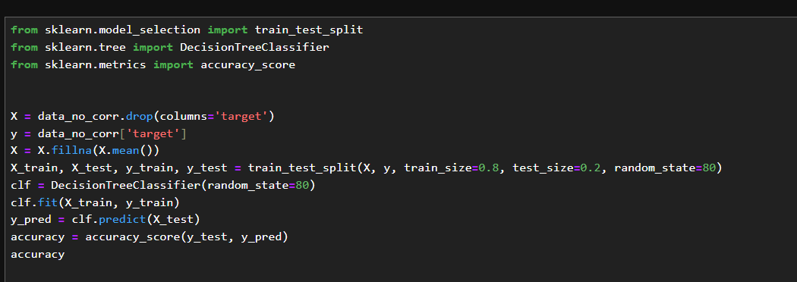
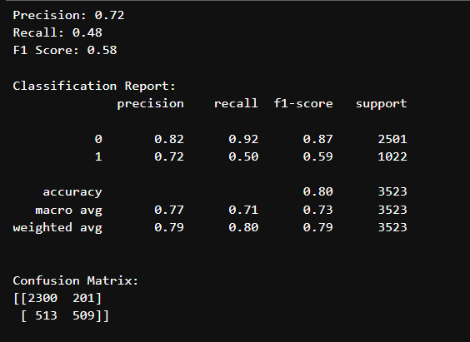
Code Snippets:

Slide 28
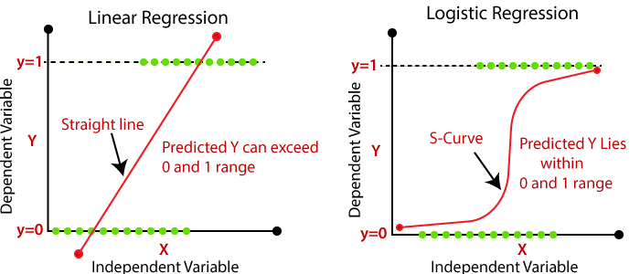
LOGISTIC REGRESSION
Logistic regression is a supervised machine learning algorithm used for classification tasks where the goal is to predict the probability that an instance belongs to a given class or not. Logistic regression is a statistical algorithm which analyze the relationship between two data factors.
Logistic regression is used for binary classification where we use sigmoid function, that takes input as independent variables and produces a probability value between 0 and 1.

Slide 29
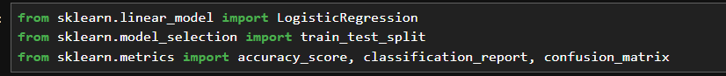
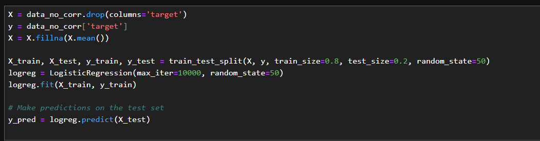
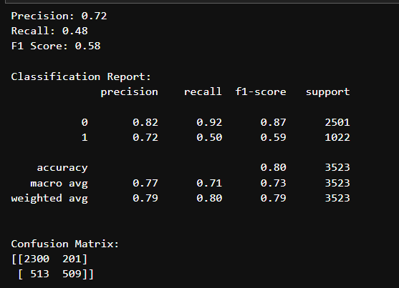
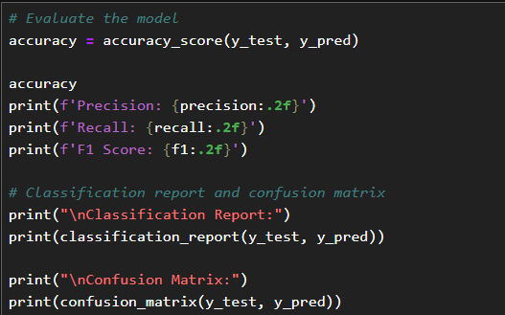
Code Snippets:

Slide 30

MILESTONE 4 Hyperparameter tuning, SVM and Confusion Matrix

Slide 31
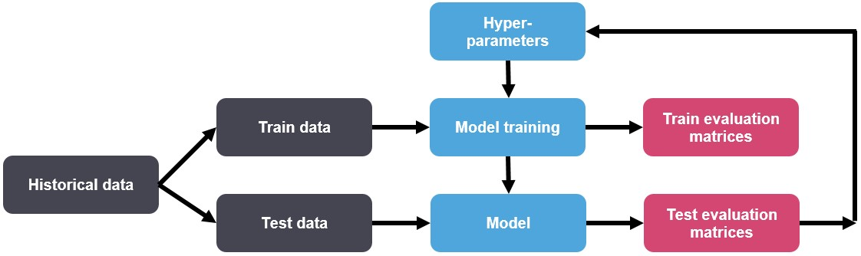
Hyperparameter tuning
Hyperparameter tuning is the process of selecting the optimal values for a machine learning model’s hyperparameters
hyperparameters are configuration variables that are set before the training process of a model begins. They control the learning process itself, rather than being learned from the data. Hyperparameters are often used to tune the performance of a model, and they can have a significant impact on the model’s accuracy, generalization, and other metrics.

Slide 32
Parameters in different modals
Random forest
n_estimators: This hyperparameter determines the number of boosting trees to be trained. A larger number of trees can improve the model’s accuracy, but it can also increase the risk of overfitting. A smaller number of trees may result in lower accuracy but can help prevent overfitting.
max_depth: This hyperparameter determines the maximum depth of each tree in the ensemble. A larger max_depth can allow the trees to capture more complex relationships in the data, but it can also increase the risk of overfitting. A smaller max_depth may result in less complex trees but can help prevent overfitting.
Logistic Regression
solver{‘lbfgs’, ‘liblinear’, ‘newton-cg’, ‘newton-cholesky’, ‘sag’, ‘saga’}, default=’lbfgs’
Algorithm to use in the optimization problem. Default is ‘lbfgs’. To choose a solver, you might want to consider the following aspects:
For small datasets, ‘liblinear’ is a good choice, whereas ‘sag’ and ‘saga’ are faster for large ones;
For multiclass problems, only ‘newton-cg’, ‘sag’, ‘saga’ and ‘lbfgs’ handle multinomial loss;
‘liblinear’ and ‘newton-cholesky’ can only handle binary classification by default.

Slide 33
Cfloat, default=1.0
Inverse of regularization strength; must be a positive float. Like in support vector machines, smaller values specify stronger regularization.
Decision Tree
criterion{“gini”, “entropy”, “log_loss”}, default=”gini”
The function to measure the quality of a split. Supported criteria are “gini” for the Gini impurity and “log_loss” and “entropy” both for the Shannon information gain
max_depth int, default=None
The maximum depth of the tree. If None, then nodes are expanded until all leaves are pure or until all leaves contain less than min_samples_split samples.
min_samples_splitint or float, default=2
The minimum number of samples required to split an internal node:
If int, then consider min_samples_split as the minimum number.
If float, then min_samples_split is a fraction and ceil(min_samples_split * n_samples) are the minimum number of samples for each split.
min_samples_leaf int or float, default=1
The minimum number of samples required to be at a leaf node. A split point at any depth will only be considered if it leaves at least min_samples_leaf training samples in each of the left and right branches. This may have the effect of smoothing the model, especially in regression.
If int, then consider min_samples_leaf as the minimum number.
If float, then min_samples_leaf is a fraction and ceil(min_samples_leaf * n_samples) are the minimum number of samples for each node.

Slide 34
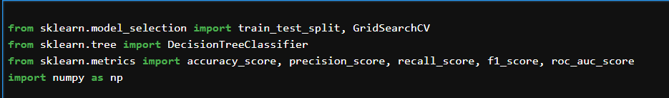
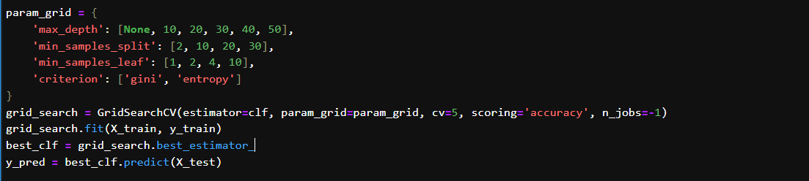
Code Snippets
# importing libraries
# Parameters for tuning

Slide 35
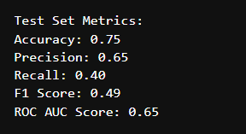
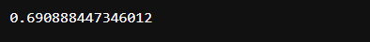
Difference Before and After performing HyperParameter tuning
Accuracy Before performing hyperparameter tuning
Accuracy after performing hyperparameter tuning

Slide 36
Advantages
Improved
model performance
Reduced
Overfitting
Optimized resource utilization
Reduced
Overfitting
Improved model interpretability
Enhanced model generalizability

Slide 37
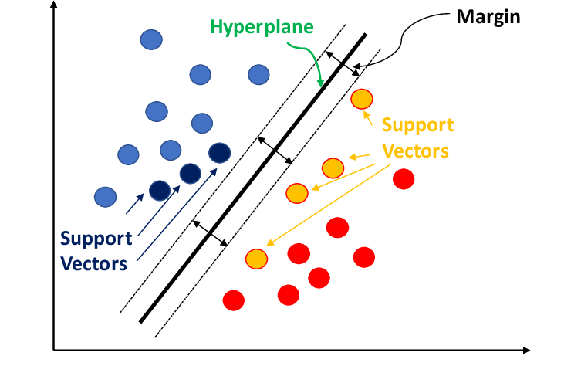
SUPPORT VECTOR MACHINE (SVM)
Support Vector Machine (SVM) is a Supervised machine learning algorithm used for both classification and regression
The main objective of the SVM algorithm is to find the optimal hyperplane in an N-dimensional space that can separate the data points in different classes in the feature space.
The hyperplane tries that the margin between the closest points of different classes should be as maximum as possible.

Slide 38
SVM Terminology
Hyperplane: Hyperplane is the decision boundary that is used to separate the data points of different classes in a feature space. In the case of linear classifications, it will be a linear equation i.e. wx+b = 0.
Support Vectors: Support vectors are the closest data points to the hyperplane, which makes a critical role in deciding the hyperplane and margin.
Margin: Margin is the distance between the support vector and hyperplane. The main objective of the support vector machine algorithm is to maximize the margin. The wider margin indicates better classification performance.
Kernel: Kernel is the mathematical function, which is used in SVM to map the original input data points into high-dimensional feature spaces, so, that the hyperplane can be easily found out even if the data points are not linearly separable in the original input space. Some of the common kernel functions are linear, polynomial, radial basis function(RBF), and sigmoid.

Slide 39
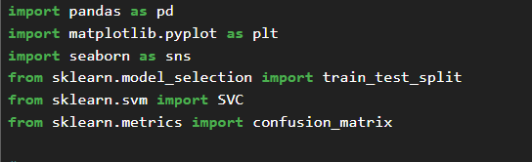
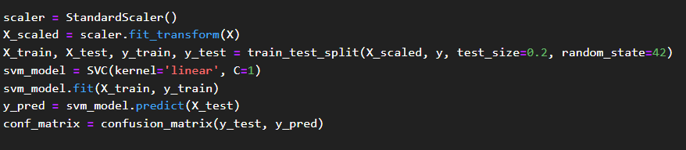
Code snippets:
# importing libraries
# performing SVM

Slide 40
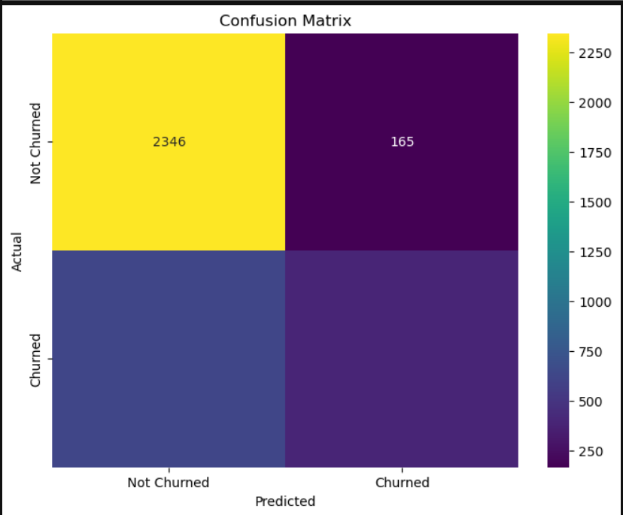
Confusion Matrix
A confusion matrix is a matrix that summarizes the performance of a machine learning model on a set of test data.
It is a means of displaying the number of accurate and inaccurate instances based on the model’s predictions. It is often used to measure the performance of classification models, which aim to predict a categorical label for each input instance.

Slide 41
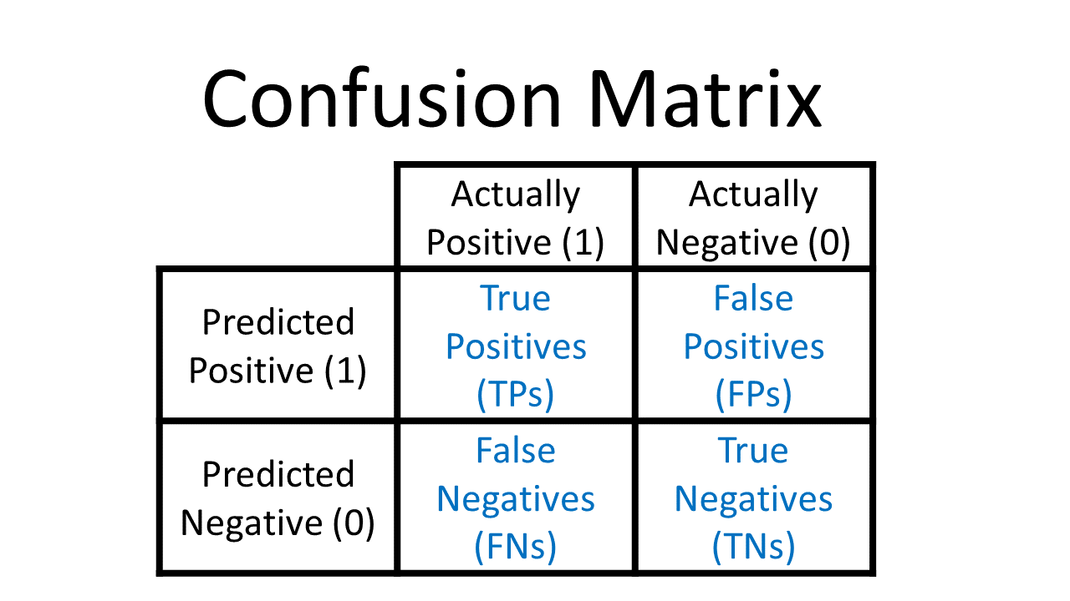
True Positive (TP): The model correctly predicted a positive outcome (the actual outcome was positive).
True Negative (TN): The model correctly predicted a negative outcome (the actual outcome was negative).
False Positive (FP): The model incorrectly predicted a positive outcome (the actual outcome was negative). Also known as a Type I error.
False Negative (FN): The model incorrectly predicted a negative outcome (the actual outcome was positive). Also known as a Type II error.

Slide 42
WHY CONFUSION MATRIX ?
Performance
measurement
Comprehensive metrix
Check imbalance insights
Model improvement

Slide 43
Metrics based on Confusion Matrix
1. Accuracy
Accuracy is used to measure the performance of the model. It is the ratio of Total correct instances to the total instances.
𝐴𝑐𝑐𝑢𝑟𝑎𝑐𝑦=𝑇𝑃+𝑇𝑁/𝑇𝑃+𝑇𝑁+𝐹𝑃+𝐹𝑁
2. Precision
Precision is a measure of how accurate a model’s positive predictions are. It is defined as the ratio of true positive predictions to the total number of positive predictions made by the model.
Precision=𝑇𝑃/𝑇𝑃+𝐹𝑃
3. Recall
It measures the effectiveness of a classification model in identifying all relevant instances from a dataset. It is the ratio of the number of true positive (TP) instances to the sum of true positive and false negative (FN) instances.
Recall=TP/FN+TP
4. F1-Score
4. F1 Score
is used to evaluate the overall performance of a classification model. It is the harmonic mean of precision and recall,
F1-Score=2*(Precision*Recall)⋅(Precision+Recall )
TP
+TN+FP+FNTP+TN

Slide 44
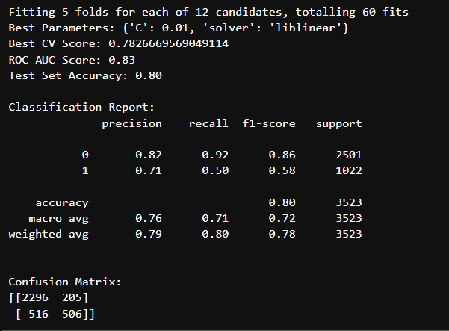
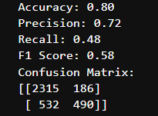
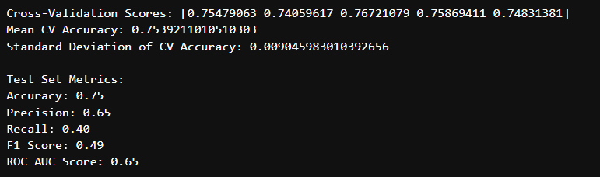
CONCLUSION
Logistic Regression
Random Forest
Decision Tree

Slide 45
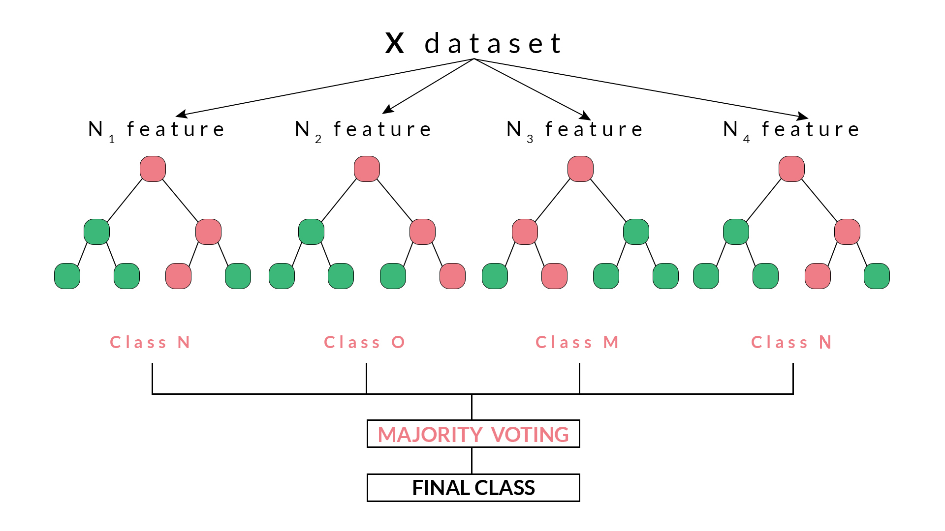
Why Random forest?
Random forest is also a very handy algorithm because the default hyperparameters it uses often produce a good prediction result. Understanding the hyperparameters is pretty straightforward, and there’s also not that many of them.
One of the biggest problems in machine learning is overfitting, but most of the time this won’t happen thanks to the random forest classifier. If there are enough trees in the forest, the classifier won’t overfit the model.

Slide 46
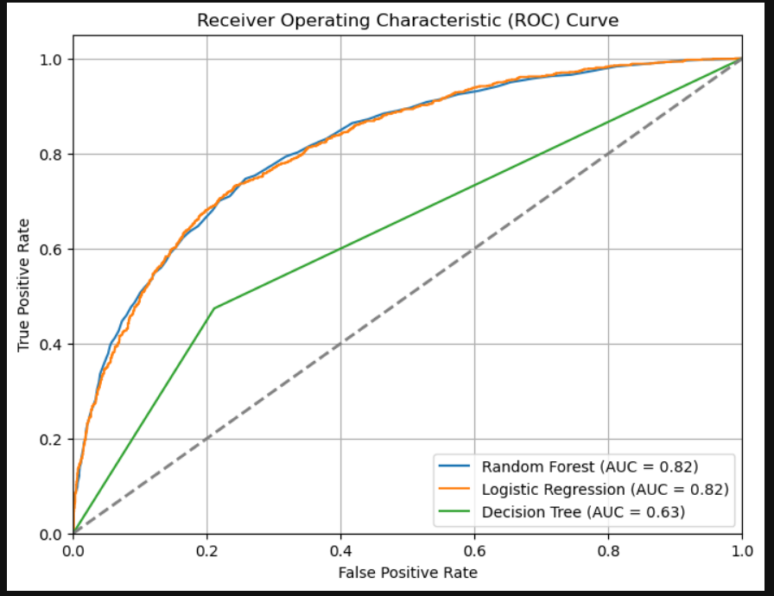
ROC AUC CURVE
It is the graphical representation of the performance of a binary classification model at various classification thresholds. It is commonly used in machine learning to assess the ability of a model to distinguish between two classes, typically the positive class (e.g., presence of a disease) and the negative class (e.g., absence of a disease).

Slide 47
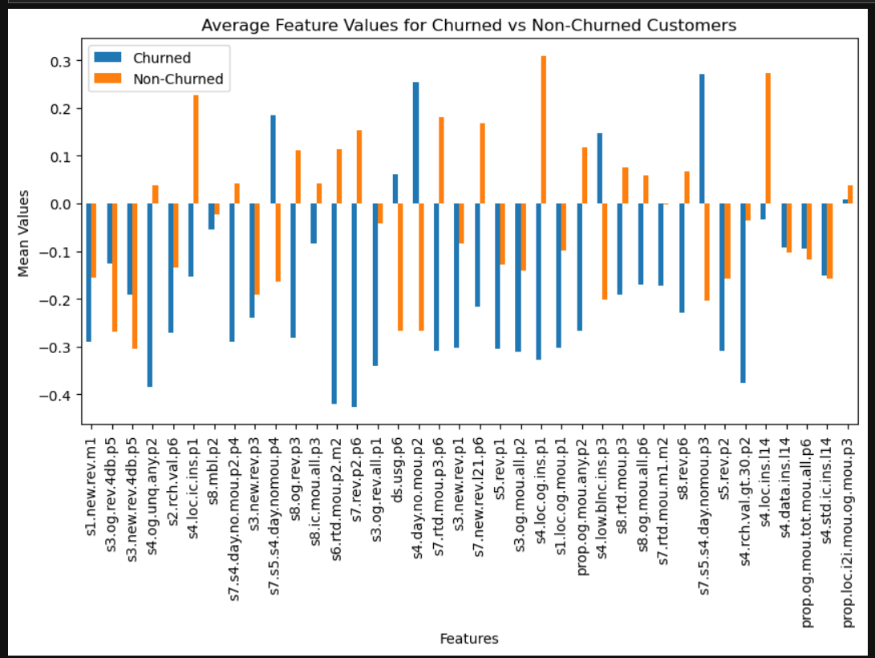

Slide 48
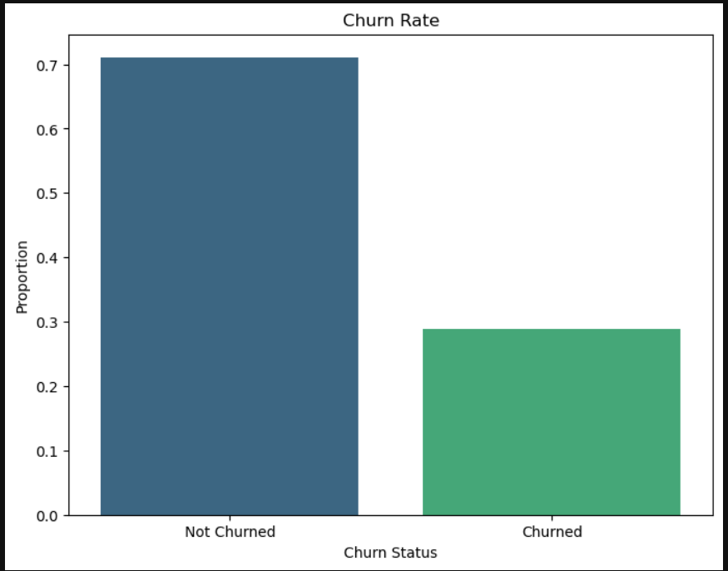
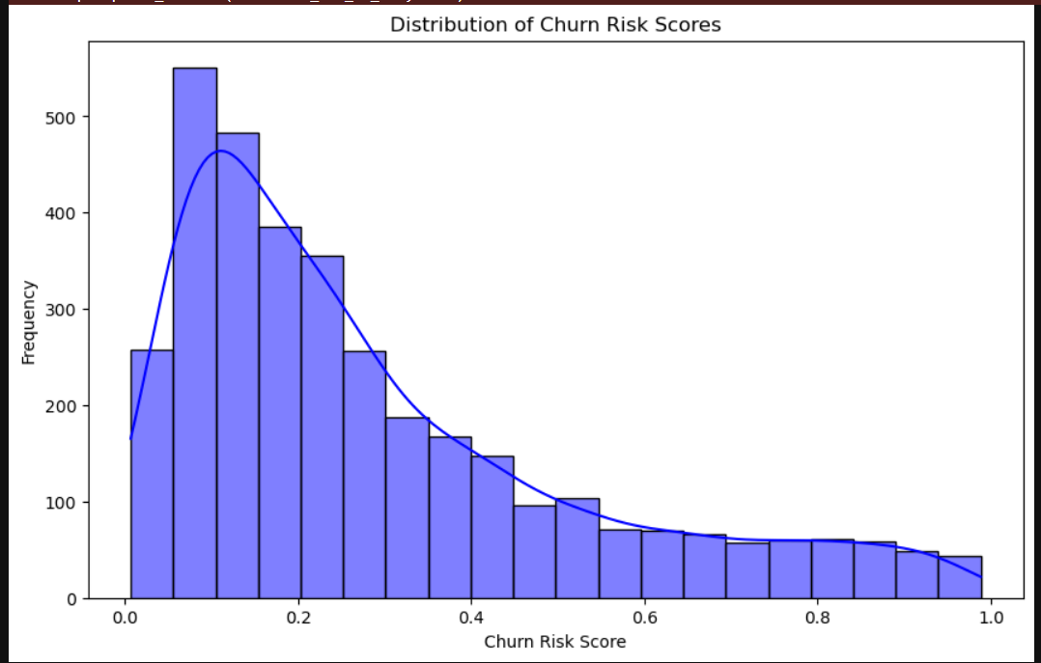

Slide 49
Post Process Actions to Reduce Churn Rate
Implementation of Retention Strategies:
Continuous Monitoring and Feedback:
Iterative Improvement
Performance Review and Reporting
Cross-Functional Collaboration:

Slide 50

THANKYOU

